Slide 1
F
Flow lines
T
Terminal symbol
start
end
Input/Output symbol
I O
P
Process symbol
D
Decision symbol
C
Connector symbol

Slide 2
ESc
gcc fileIdentifier.c –o fileIdentifier.exe
linking ~ output to fileIdentifier.s
gcc –c fileIdentifier.c –o fileIdentifier.s
assembling ~ output to fileIdentifier.s
gcc –S fileIdentifier.c –o fileIdentifier.o
compiling ~ output to fileIdentifier.o
gcc –E fileIdentifier.c –o fileIdentifier.r
gcc –E fileIdentifier.c –o fileIdentifier.r
preprocessing ~ output to fileIdentifier.r

Slide 3
datatypes
Primary
Derived
Enumeration
Void
int
float
double
char
array
pointer
structure
union
enum
void
format specifier
%d
%f
%c
primarydatatype variableIdentifier = ...
primarydatatype arrayIdentifier[] = .....

Slide 4


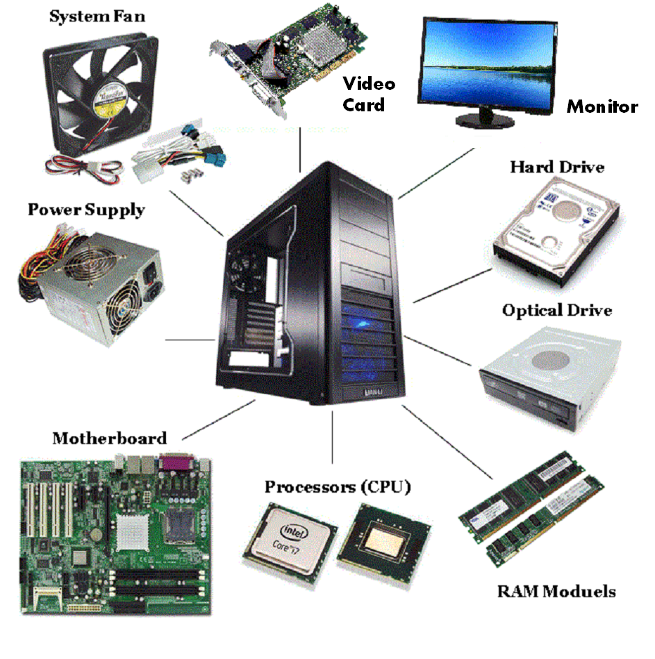

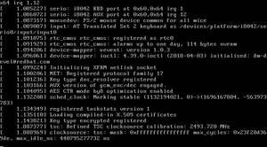
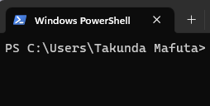

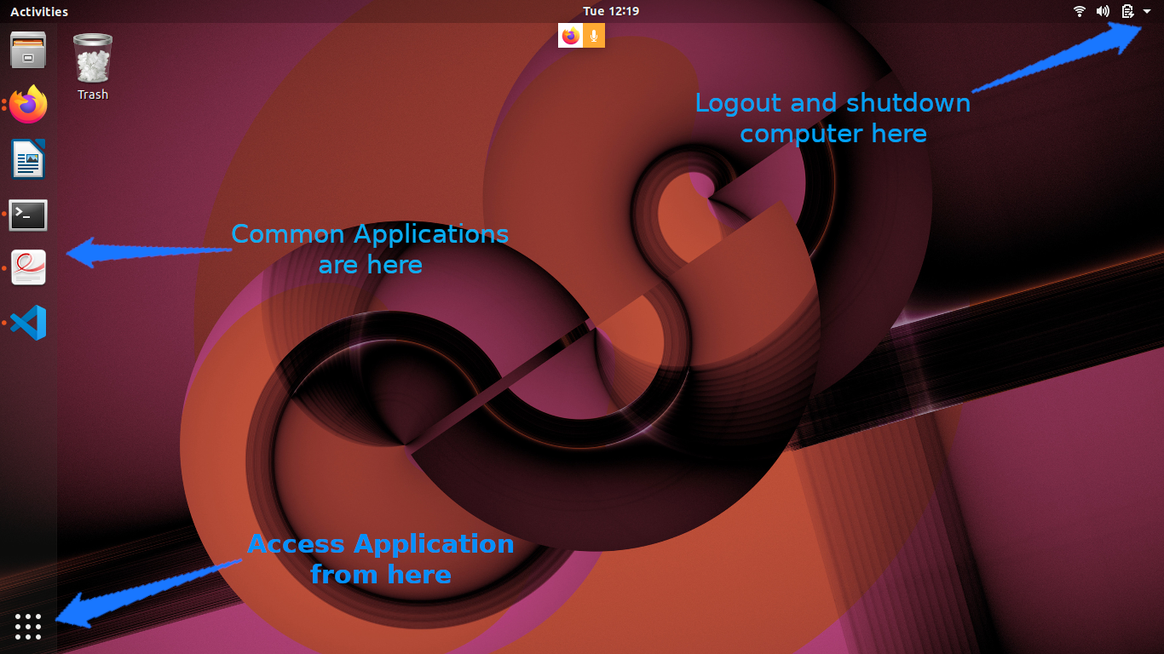

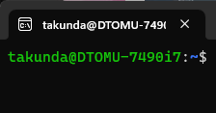
Applications (Apps)
Operating System (OS)
Devices
User Space Processes
Shell
Kernel
Hardware
(OS frontend)
(OS backend)
Windows Operating System
Windows
GUI
Windows
Kernel
Windows
CLI
Ubuntu Operating System
Ubuntu
GUI
Linux
Kernel
Ubuntu
CLI

Slide 5
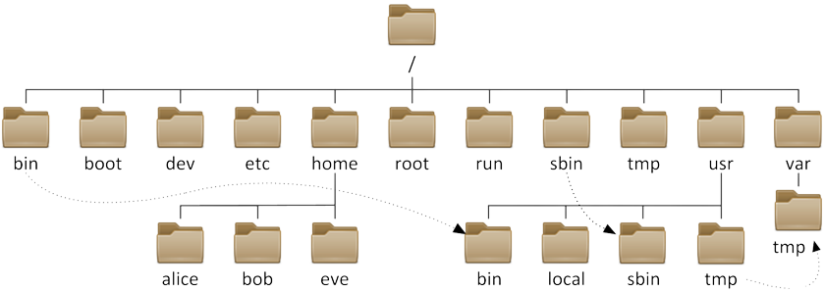

Slide 6


/
KEY
root
possible path-starting directory
lineage directory
~/
other sibling directory
home
root
gandparent
parent
/
~
./../../
./../
./
./child1/
./child1/grandchild1/
previous
current
-
child1
grandchild1

Slide 7
You cannot create multiple files with the same name
./
current
child1
child1

Slide 8
Start
End
Absoute Path
/
~/
Dir/
Dir/
Dir/
Dir/
Relative Path
./
app/
src/
js/
example
../
../
src/

Slide 9

remote repository
git push
git pull
local repository

Slide 10
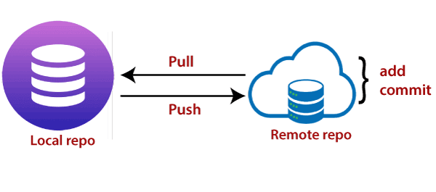

Slide 11
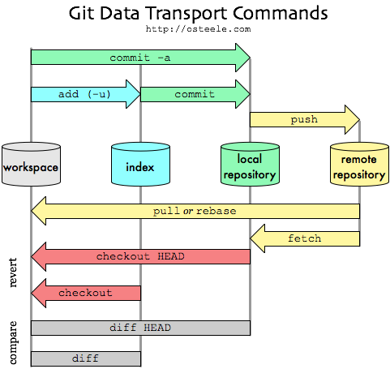

Slide 12
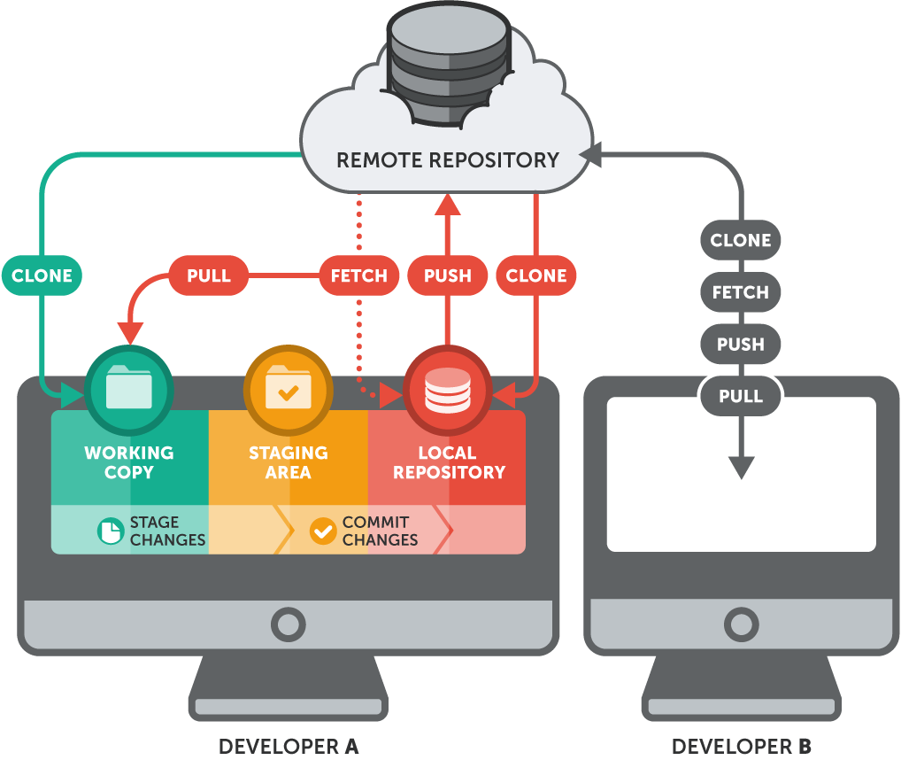
git push
git add
git commit

Slide 13


Slide 14
command
r w x
chmod
permissions
path1/file1
 |  | u | g | o | + - | r | w | x
chmod

Slide 15
 |  |  |  |  | +
 |  | u | g | o |  | r | w | x |  |  | file
 |  |  |  |  | - |  |  |  |  |  | directory/
chmod |  |  |  |  |  |  |  |  |  | path/

